Slide 1
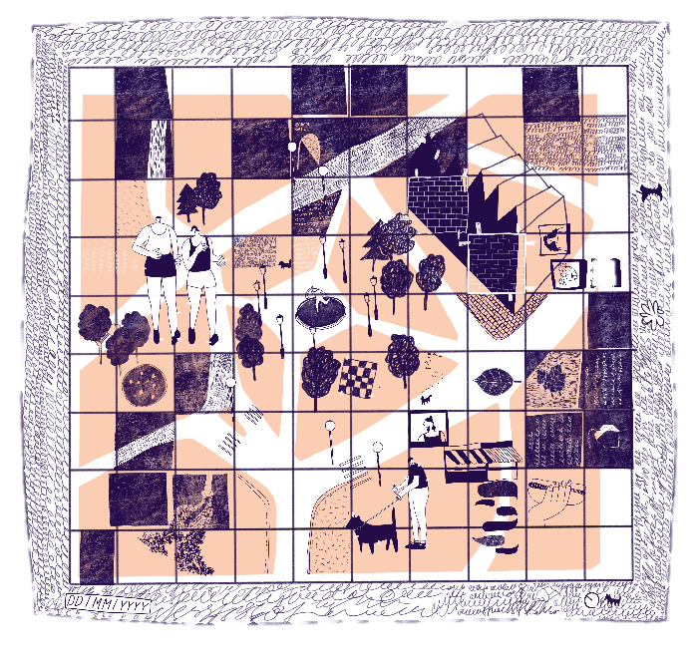
Right to the City
KS4 | Learning Point
Learning aims
Deepen understanding of democracy, government and the rights and responsibilities of citizens.
To develop understanding and awareness of how to be an active and engaged citizen, able to participate in the conversations that shape our built environment.
^{RIBA}
^{Learning_Citizenship Activity}

Slide 2
Active citizenship:
‘is about how people behave towards one another, whether they help and support each other in their communities and work together in groups to improve things for everyone.
Active citizens are people who have opinions and want these to be heard.
They use democratic processes to make things happen, in their school, college, workplace or community.’
Agency:
‘the capacity, condition, or state of acting or of exerting power’
^{RIBA}
^{Learning_Citizenship Activity}

Slide 3
Citizenship:
‘The legal status attached to being regarded as a citizen of a country. (...)
The rights responsibilities and obligations that people have in their local community or country’
Community:
‘A group of people who live in a particular geographical locality. (...)
A group whose members share common interests and values’
^{RIBA}
^{Learning_Citizenship Activity}

Slide 4
Democracy:
A system said to be ‘of the people, by the people, for the people. (...)
A system of government where people regularly elect their leaders and have a say in a way a country is governed’
Empathy:
‘Imagining and understanding other people’s point of view’ and ‘the action of understanding, being aware of, being sensitive to, and vicariously experiencing the feelings, thoughts, and experience of another of either the past or present without having the feelings, thoughts, and experience fully communicated in an objectively explicit manner’
^{RIBA}
^{Learning_Citizenship Activity}

Slide 5
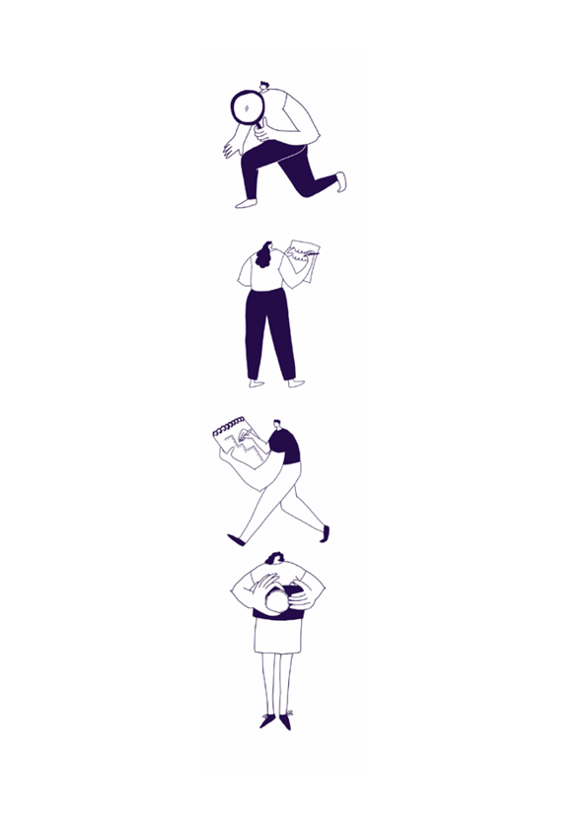
Global citizenship:
A global citizen has an ethic of care for the world or an Amor Mundi (love of the world)
Oxfam say in 1997 ‘We see the Global Citizen as someone who:
- is aware of the wider world and has a sense of their own role as a world citizen
- respects and values diversity
- has an understanding of how the world works economically, politically, socially,
culturally, technologically and environmentally
- is outraged by social injustice
- participates in and contributes to the community at a range of levels from the local to
the global
- is willing to act to make the world a more equitable and sustainable place
- takes responsibility for their actions’
^{RIBA}
^{Learning_Citizenship Activity}

Slide 6
Grass roots:
Grass roots means ‘by the people for the people’. Grass roots community groups have been started by local inhabitants to remedy a local issue with local means independently, and often informally.
One of the earliest uses of the term grassroots was by Albert Beveridge who said:
‘This party [the Progressive Party] comes from the grass roots. It has grown from the soil of the people’s hard necessities.’
^{RIBA}
^{Learning_Citizenship Activity}

Slide 7
Human rights:
‘Rights that are held to belong to any person. The United Nations Universal Declaration of Human Rights, 1948, sets out a full list of the rights that all people should have. These include the right to life, liberty, education, freedom of movement and equality before the law’
^{RIBA}
^{Learning_Citizenship Activity}

Slide 8
Right to the city:
A concept introduced by the urban theorist Henri Lefebvre in 1968 Le Droit à la ville, which is a ‘demand…[for] a transformed and renewed access to urban life’.
Anthropologist and Geographer David Harvey goes further by saying:
‘The right to the city is far more than the individual liberty to access urban resources: it is a right to change ourselves by changing the city. It is, moreover, a common rather than an individual right since this transformation inevitably depends upon the exercise of a collective power to reshape the processes of urbanization.
The freedom to make and remake our cities and ourselves is, (...) one of the most precious yet most neglected of our human rights.’
^{RIBA}
^{Learning_Citizenship Activity}

Slide 9
Place:
The geographic characteristics of a locality, and the feeling or perception of a space or series of spaces.
^{RIBA}
^{Learning_Citizenship Activity}

Slide 10
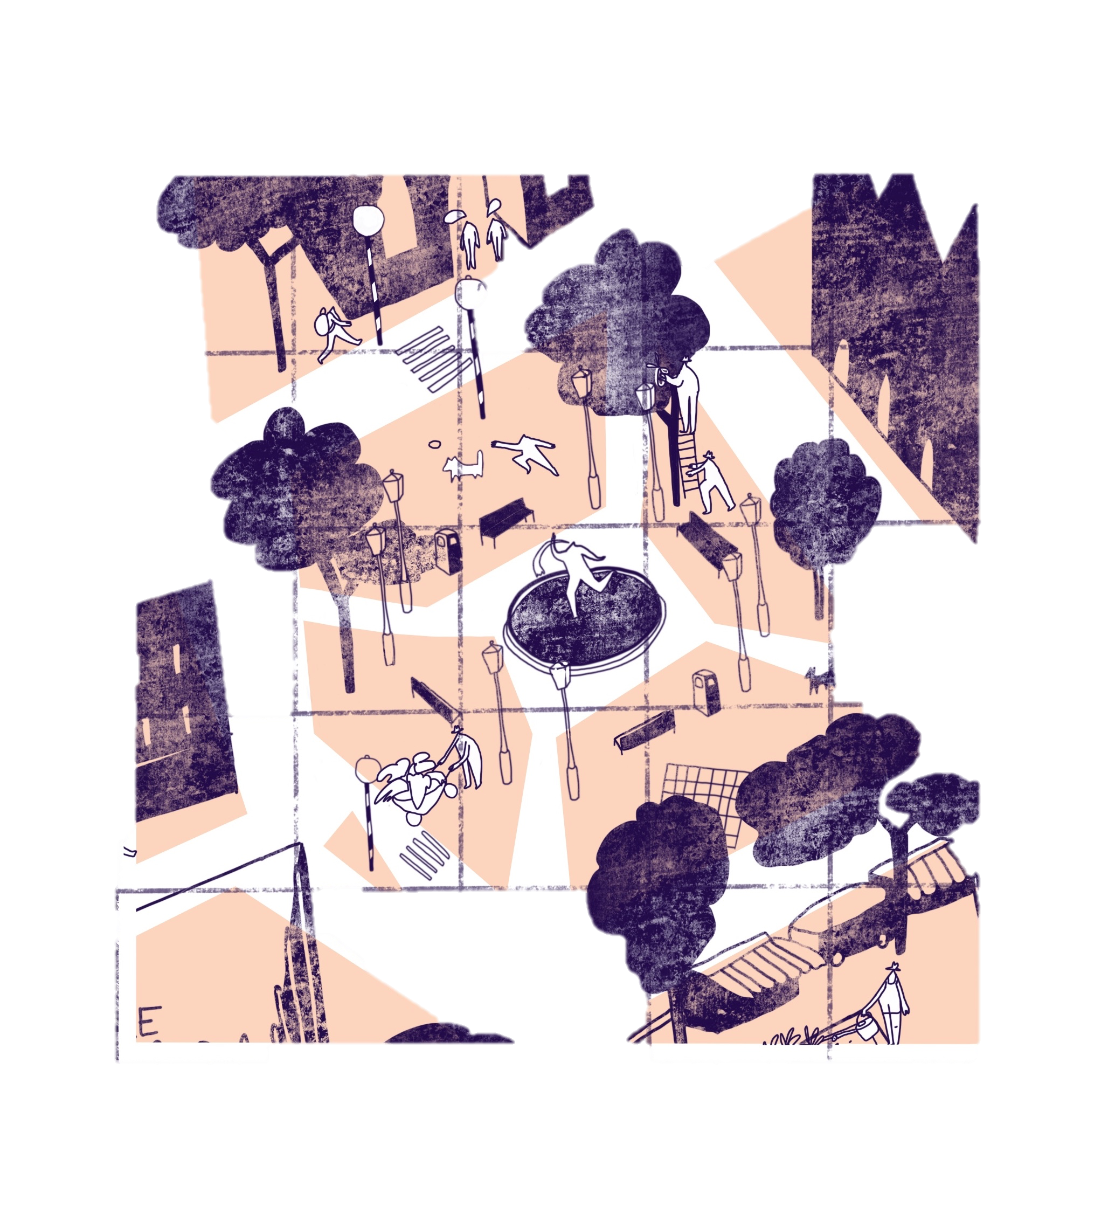
Activity One /
Politics of Place
1. Think about how these terms relate specifically to your local environment. To the streets, parks, buildings and green spaces near you. Can you think of an example for each term?
^{RIBA}
^{Learning_Citizenship Activity}

Slide 11
Activity One /
Politics of Place
2. How can the (built) environment be (more) democratic?
What would democratic design decisions/activities look like and how would they be implemented?
^{RIBA}
^{Learning_Citizenship Activity}

Slide 12
Activity One /
Politics of Place
3. How can we increase our right to the city?
^{RIBA}
^{Learning_Citizenship Activity}

Slide 13
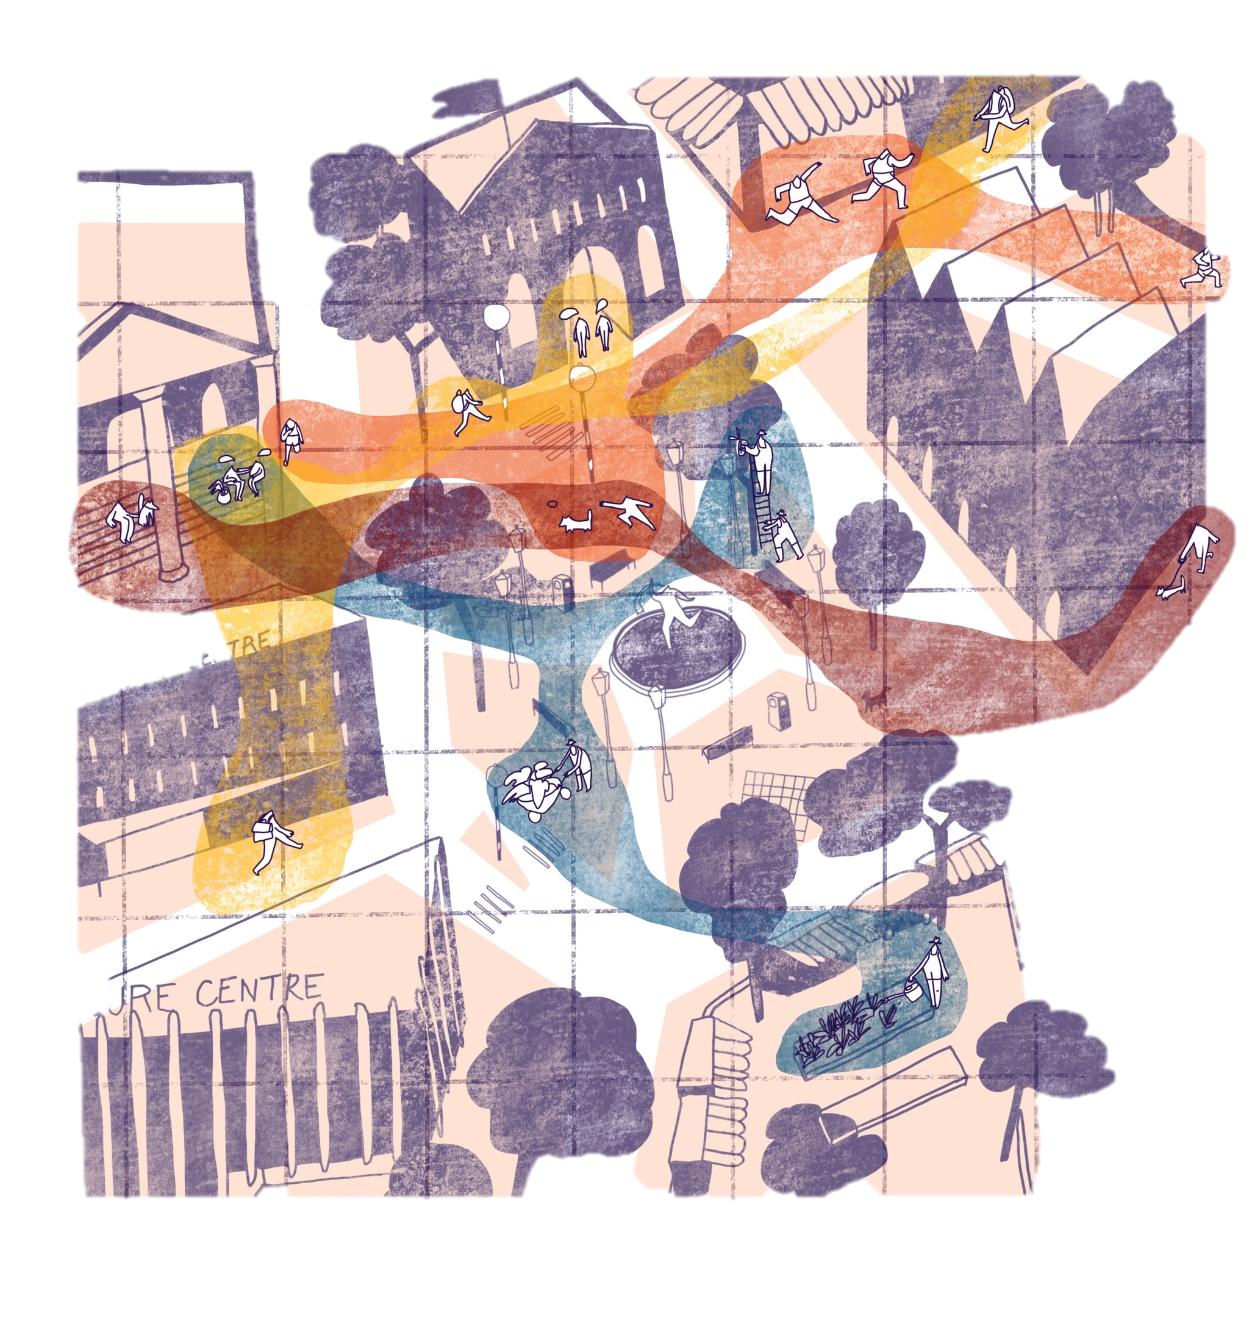
Activity Two/
Community Agency
^{RIBA}
^{Learning_Citizenship Activity}

Slide 14
Activity Two / Community Agency
Communities
Which different communities can you think of that are local to you or your school area?
What makes them communities? Why? Are there community crossovers?
What are the (formal and informal) boundaries of the area the communities focus on?
Are there informal boundaries to the communities or the areas the groups focus on? What are these? Why?
How are communities visible in the public realm? (High Street, residential streets, buildings, public spaces)
Where do communities cross over?
^{RIBA}
^{Learning_Citizenship Activity}

Slide 15
Activity Two / Community Agency
Grassroots community groups - Local agency
1. Which community groups can you think of that are active in your area?
2. What particular activities do these communities or groups carry out? For whom? Why?
3. Do they engage with singular or multiple communities? If yes, how do the community groups engage with a variety of communities?
^{RIBA}
^{Learning_Citizenship Activity}

Slide 16
Next Week / Walkabout
‘Transect Walk and Transactional Drawing’, by Benjamin Barth,
Bergen Arkitekt Skole, 2009 © Benjamin Barth
They were made as an attempt to document physical and psychological barriers and/or «thresholds» in the built environment, on the route between Bergen School of Architecture and across the city centre of Bergen.
^{RIBA}
^{Learning_Citizenship Activity}

Slide 17
Next Week / Walkabout
‘Transect Walk and Transactional Drawing’, by Benjamin Barth,
Bergen Arkitekt Skole, 2009 © Benjamin Barth
They were made as an attempt to document physical and psychological barriers and/or «thresholds» in the built environment, on the route between Bergen School of Architecture and across the city centre of Bergen
^{RIBA}
^{Learning_Citizenship Activity}

