Slide 1
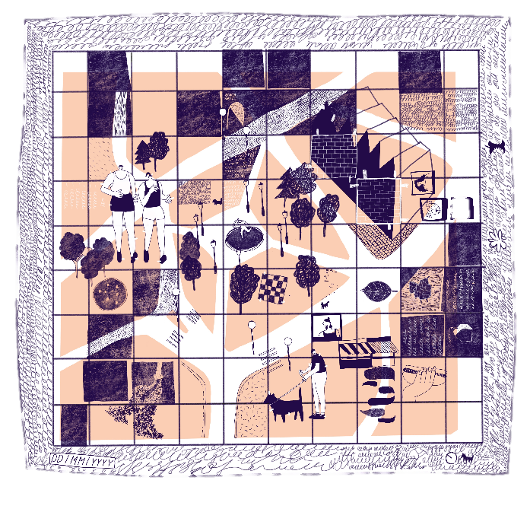

Map Making
KS4 | Learning Point
Learning aims
Deepen understanding of democracy, government and the rights and responsibilities of citizens.
To develop understanding and awareness of how to be an active and engaged citizen, able to participate in the conversations that shape our built environment.
^{RIBA}
^{Learning_Citizenship Activity}

Slide 2
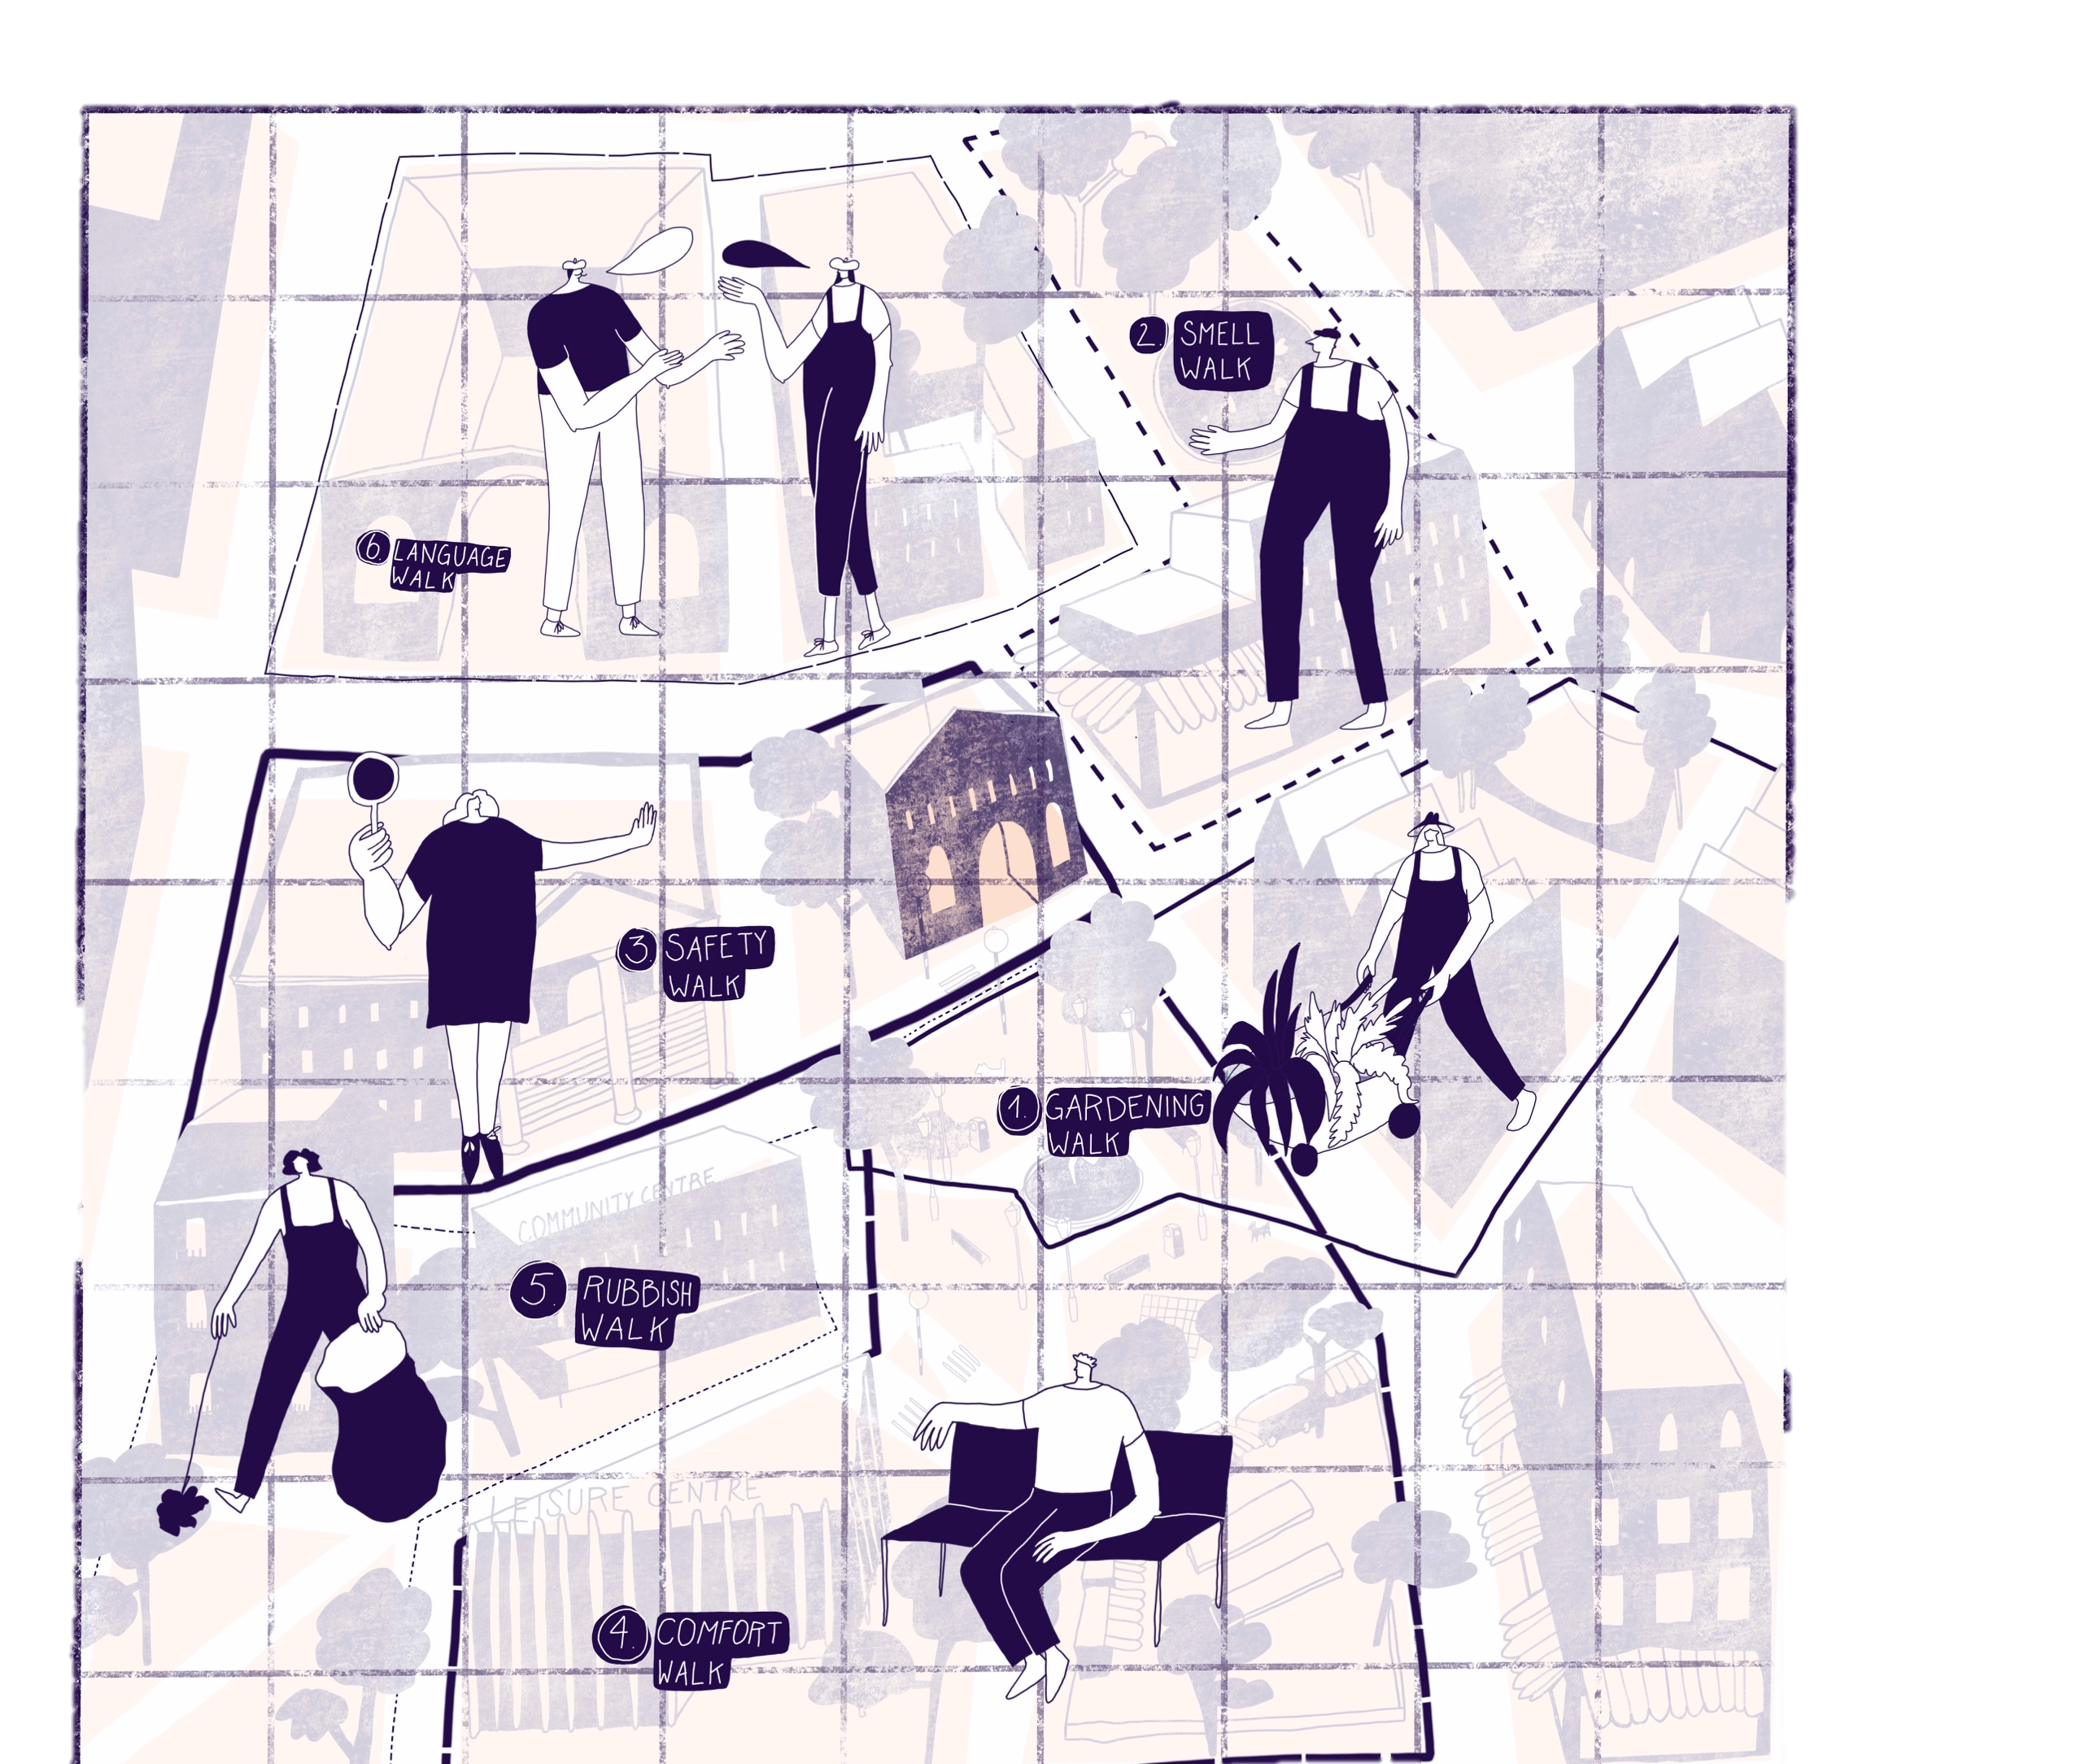
Activity One /
Map Making
^{RIBA}
^{Learning_Citizenship Activity}

Slide 3
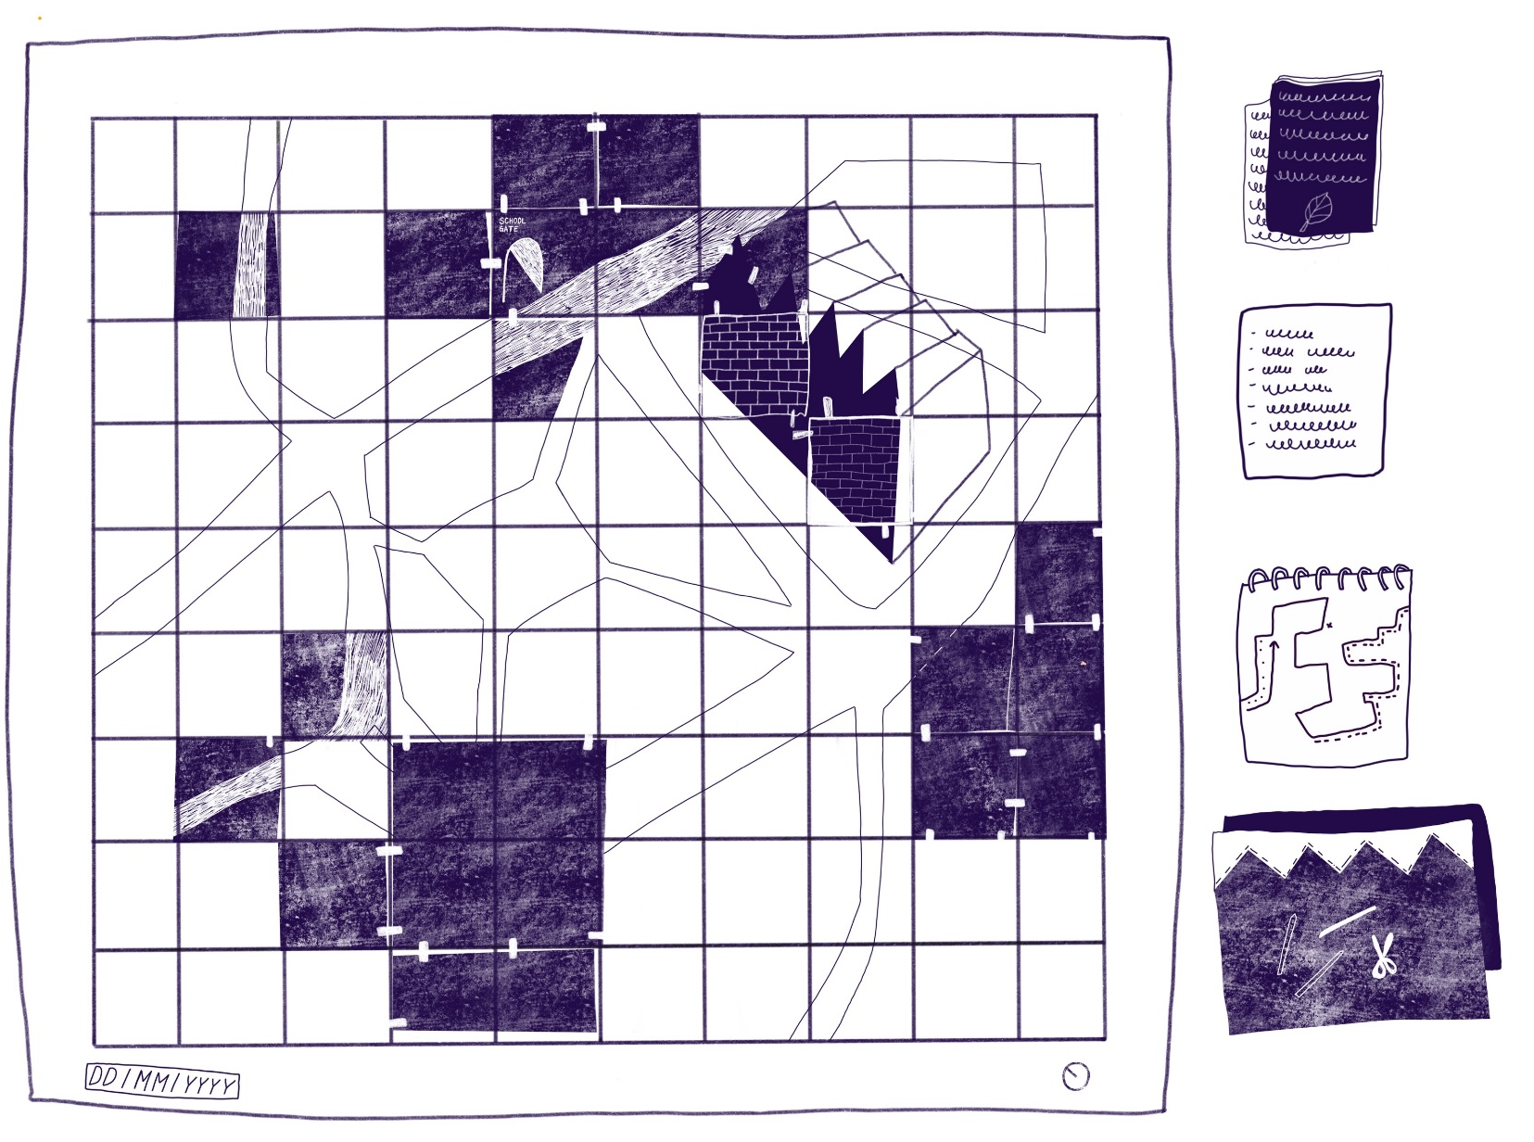
Activity One /
Step 1
1. Place your printed photographs along your routes. You can glue these in place when you are happy with their position.
^{RIBA}
^{Learning_Citizenship Activity}

Slide 4
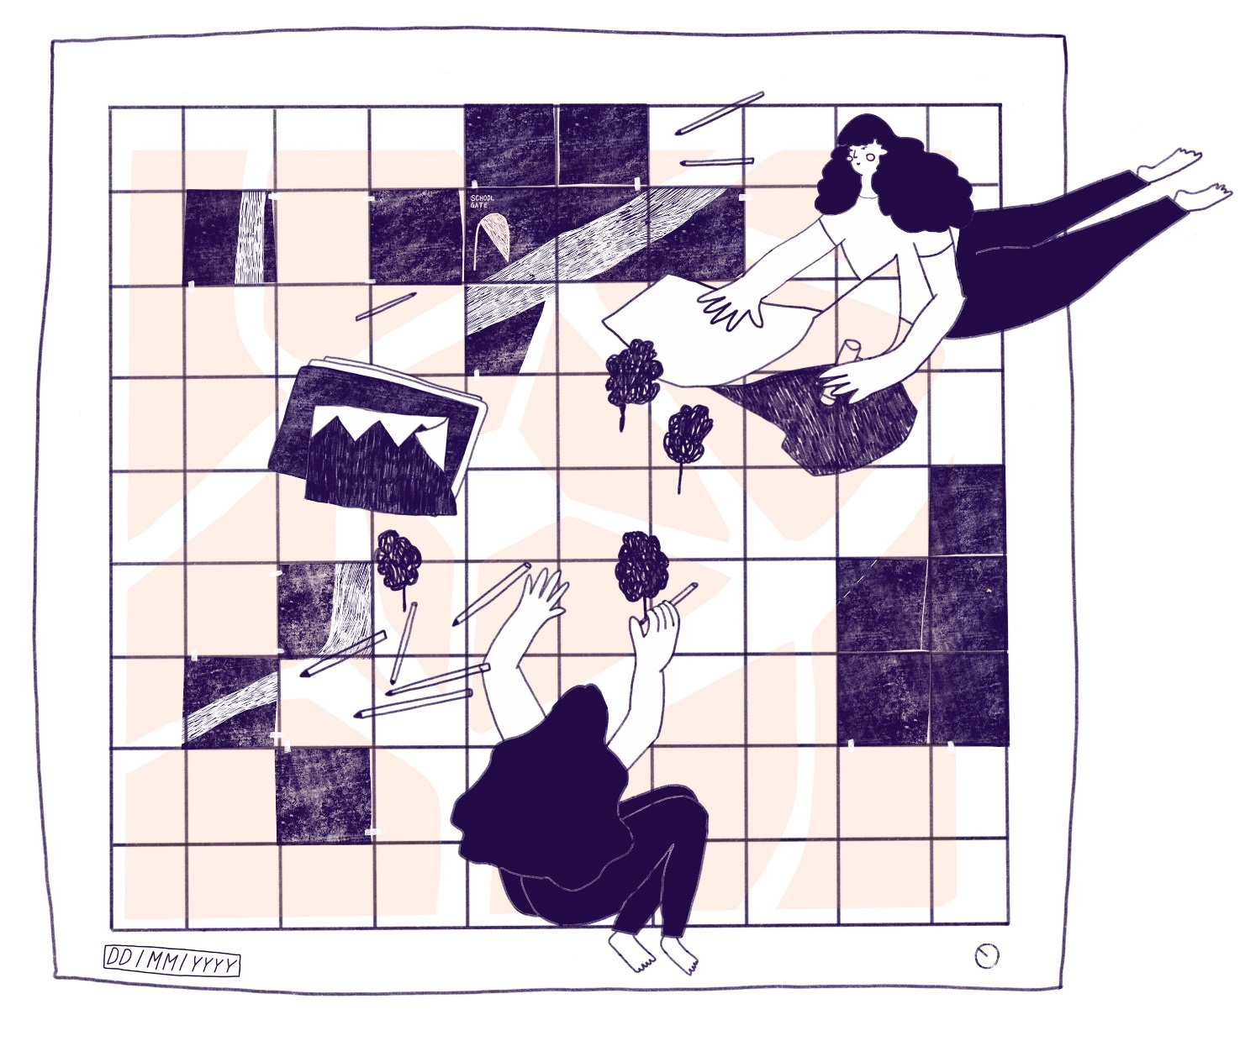
Activity One /
Step 2
2. Locate and illustrate your landmarks. These can be small or large, for example a bench a road or a church.
^{RIBA}
^{Learning_Citizenship Activity}

Slide 5
Activity One /
Step 3
3. Write down and illustrate your field notes from your transect diagrams.
^{RIBA}
^{Learning_Citizenship Activity}

Slide 6
Activity One /
Step 4
4. What were people doing? Which spaces were they using?
^{RIBA}
^{Learning_Citizenship Activity}

Slide 7
Activity One /
Step 6
4. What were people doing? Which spaces were they using?
You can use annotation to add information too.
^{RIBA}
^{Learning_Citizenship Activity}

Slide 8
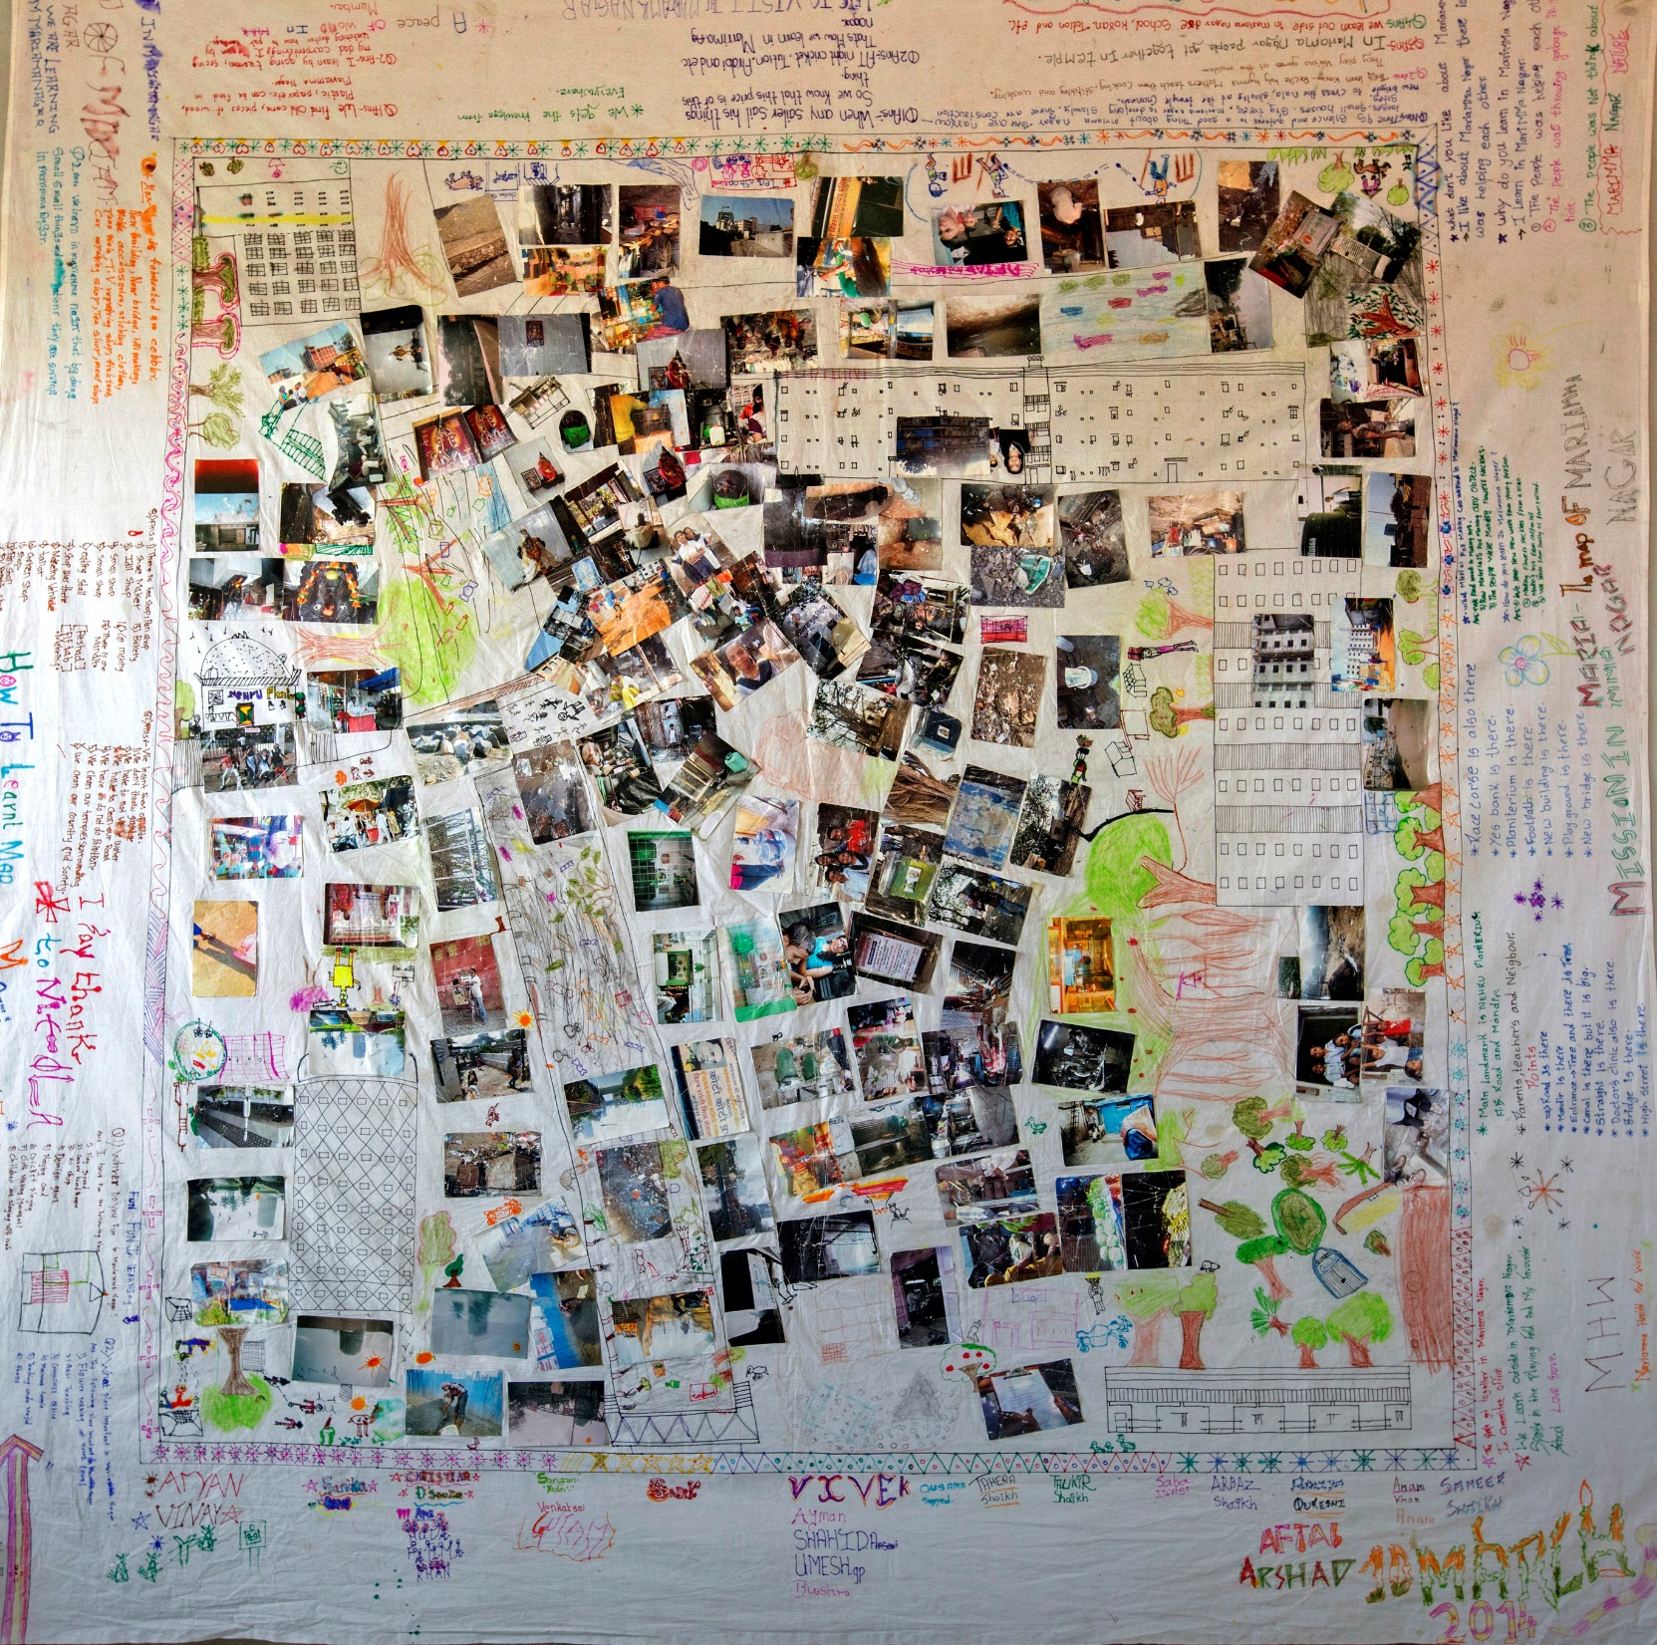
Next Week / Walkabout
‘Map of neighbourhood Mariamma Nagar in Mumbai, India’ by the students of Lovegrove 6th Standard
Using photographs, drawings and annotation, the students made a map of how they felt they learnt in their neighbourhood.
Image from ‘A Learning Architecture’ by Nicola Antaki, 2014 © Nicola Antaki
^{RIBA}
^{Learning_Citizenship Activity}

Slide 9
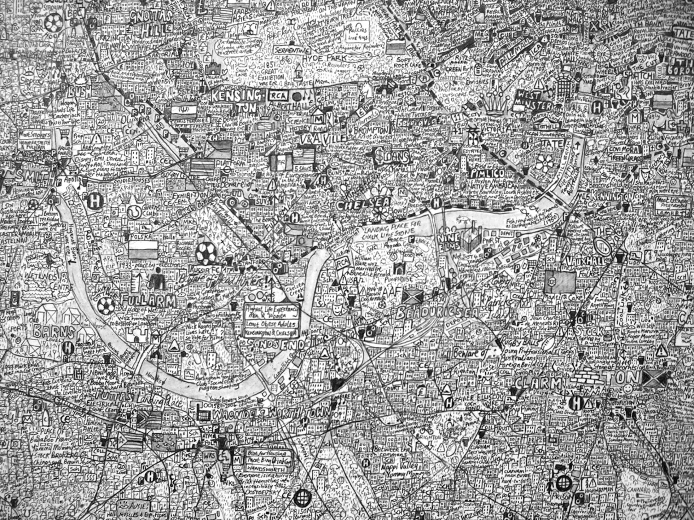
Next Week / Walkabout
Image taken from ‘The Island’, by Stephen Walter, 2008
© Stephen Walter
Image courtesy of Stephen Walter & TAG Fine Arts, London
^{RIBA}
^{Learning_Citizenship Activity}

Slide 10
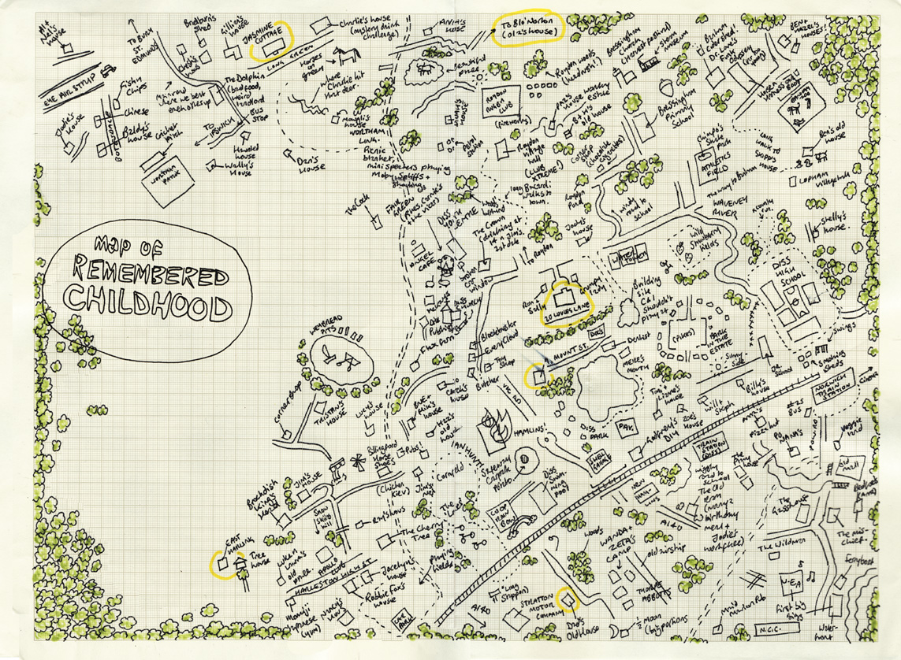
Next Week / Walkabout
Map of Childhood Memories by Harriet McDougall, date unknown
© Harriet McDougall
This map shows the artist’s childhood memories in relation to one another, making a spatial representation of memory as a place.
^{RIBA}
^{Learning_Citizenship Activity}

