Slide 1
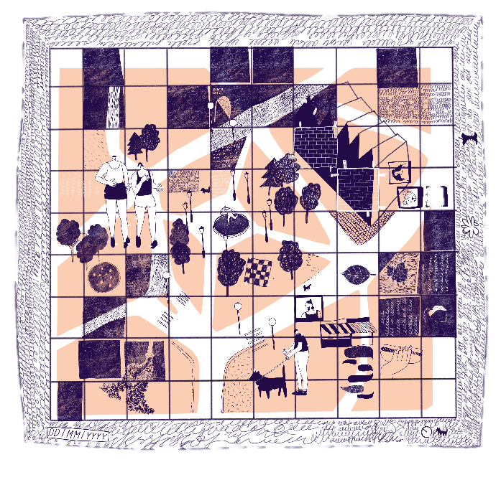
Community Themes
KS4 | Learning Point
Learning aims
Deepen understanding of democracy, government and the rights and responsibilities of citizens.
To develop understanding and awareness of how to be an active and engaged citizen, able to participate in the conversations that shape our built environment.
^{RIBA}
^{Learning_Citizenship Activity}

Slide 2
Activity One /
Finishing your map
Have you included everything you noted on your walkabout?
What could you add that is missing?
^{RIBA}
^{Learning_Citizenship Activity}

Slide 3
Discussion:
What issues have you highlighted in your map?
Are local inhabitants already working towards solving some of these issues? If so, which of the community groups you identified in session one are tackling the issues you have highlighted?
What project would you like to work on next on the basis of your walkabout, documentation and mapping? Which community group could you work with on this?
How do you feel your understanding of the terms defined in session one has changed?
^{RIBA}
^{Learning_Citizenship Activity}

Slide 4
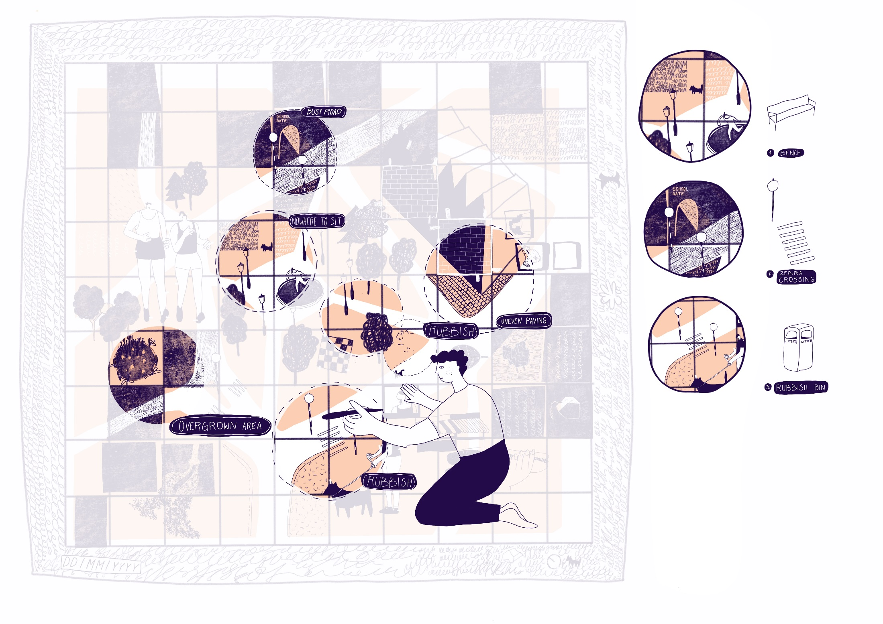
Activity Two/
Display
Share your findings with others. Your map could be displayed vertically, or shown flat on the ground.
Could you present your map and findings to the rest of the school in assembly?
^{RIBA}
^{Learning_Citizenship Activity}

Slide 5
Continuing projects:
This mapping project will have set foundations for further work with the community in your local area.
Could you volunteer at one of the community groups you identified?
Could you lead a project on one of the themes you identified?
^{RIBA}
^{Learning_Citizenship Activity}

Slide 6
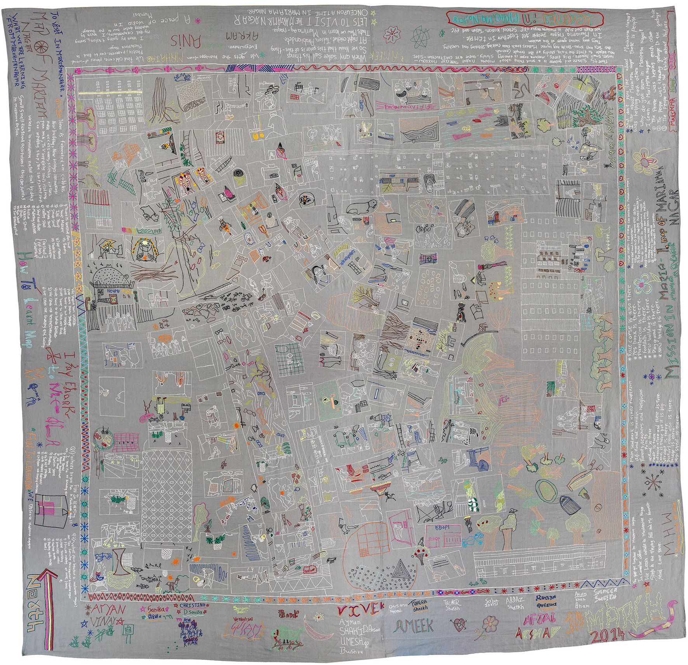
Reference /
Embroidered map of informal settlement, Mariamma Nagar
Image from ‘A Learning Architecture’ by Nicola Antaki, 2014 © Nicola Antaki
^{RIBA}
^{Learning_Citizenship Activity}

