Slide 1
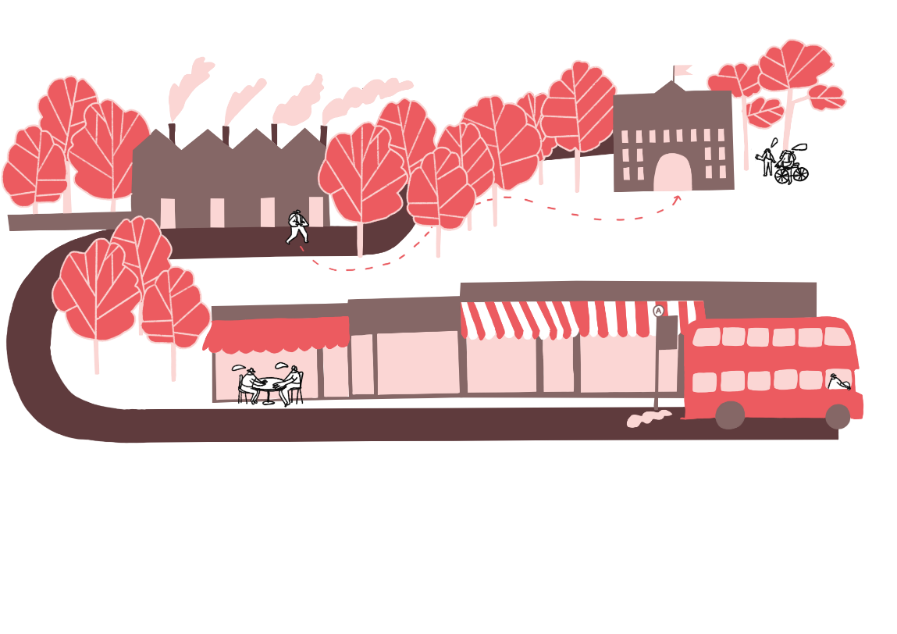

Exploring Archives
^{‘LET’S MAKE A CHANGE!’}
KS2 | Learning Aims
Architecture | Learning Points
To be curious to know more about the past.
To ask perceptive questions and to think critically.
- Students are able to discuss what archives can tell us about the past
- Students produce an object for the class archive
^{RIBA}
^{Learning_Mathematics Activity}

Slide 2

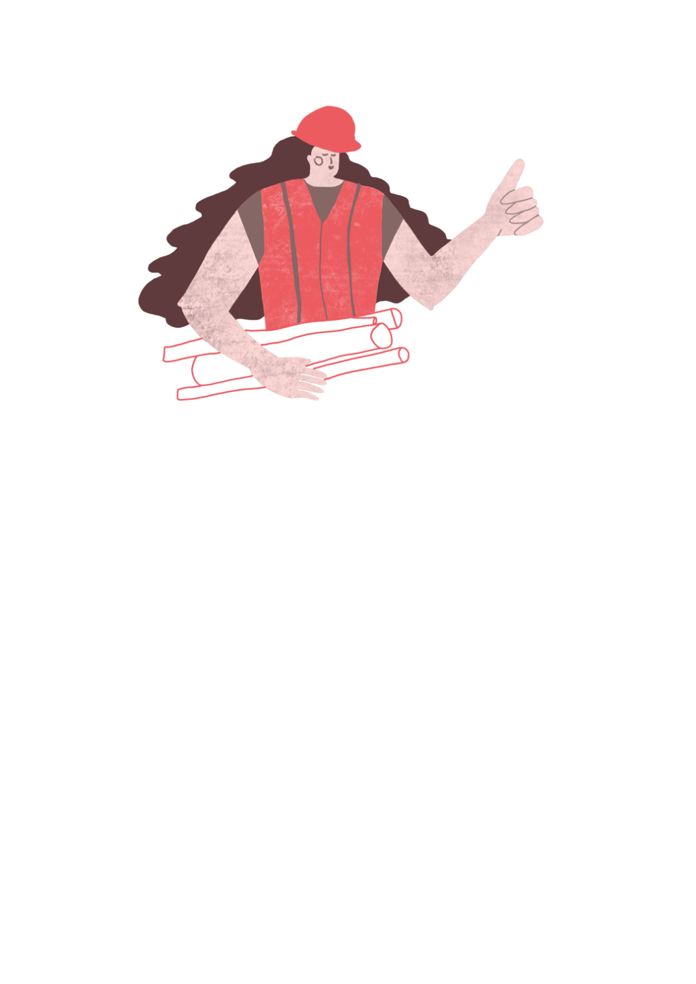
People and places
Place-based learning is about exploring the area and locality where we live.
^{RIBA}
^{Learning_Mathematics Activity}

Slide 3
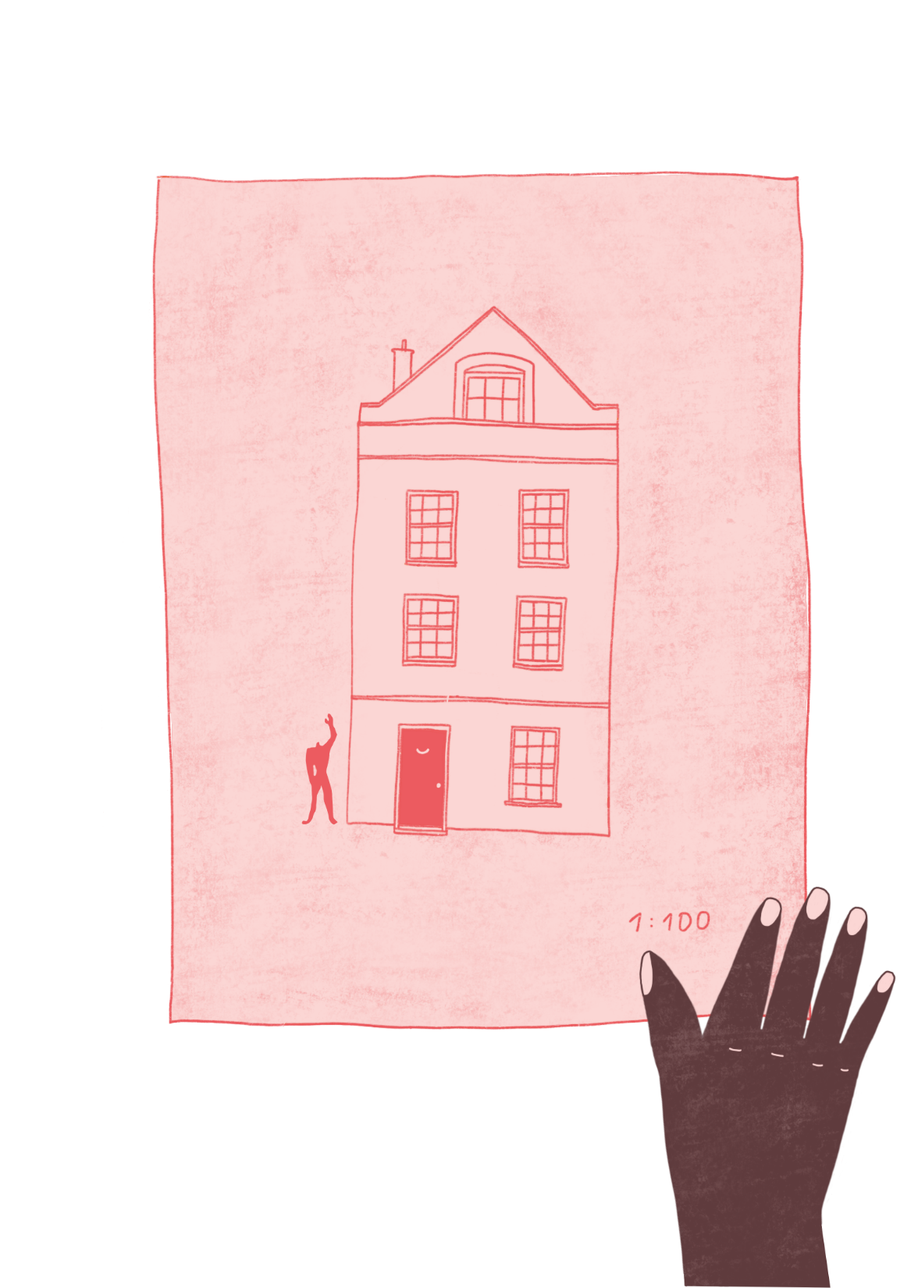
“An Archive is a collection…”
Stories
Memories
Historical events
Buildings and places
Archives can be public or private.
^{RIBA}
^{Learning_Mathematics Activity}

Slide 4
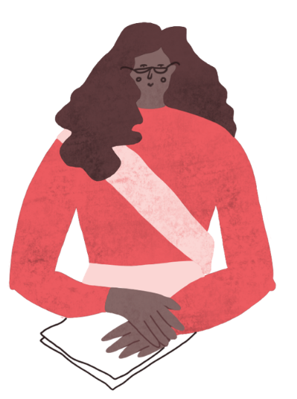
Note to teacher: Insert images of your local area from RIBApix.
https://www.architecture.com/image-library/ribapix.html
“What can we learn about the geography and history of our local area by looking at the collection the RIBA holds on the region.”
^{RIBA}
^{Learning_Mathematics Activity}

Slide 5
Note to teacher: Insert images of your local area from RIBApix.
https://www.architecture.com/image-library/ribapix.html
“What can we learn about the local area from the RIBA Collection?
These images are part of the RIBA Collection recording the architectural history of your area”
^{RIBA}
^{Learning_Mathematics Activity}

Slide 6
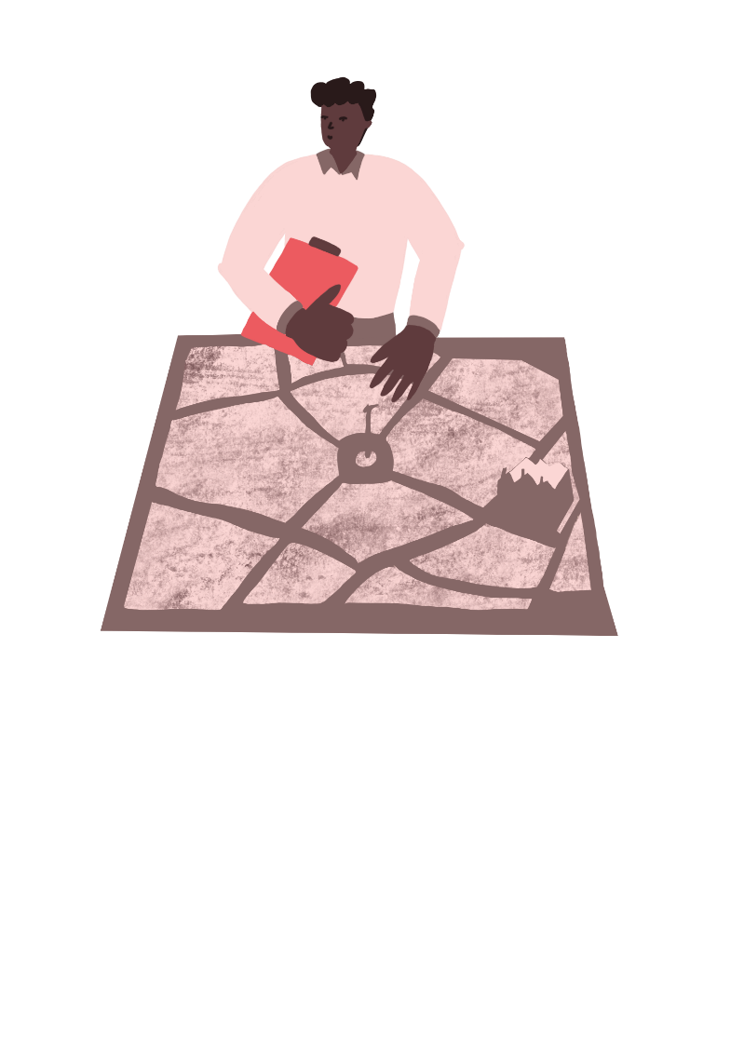
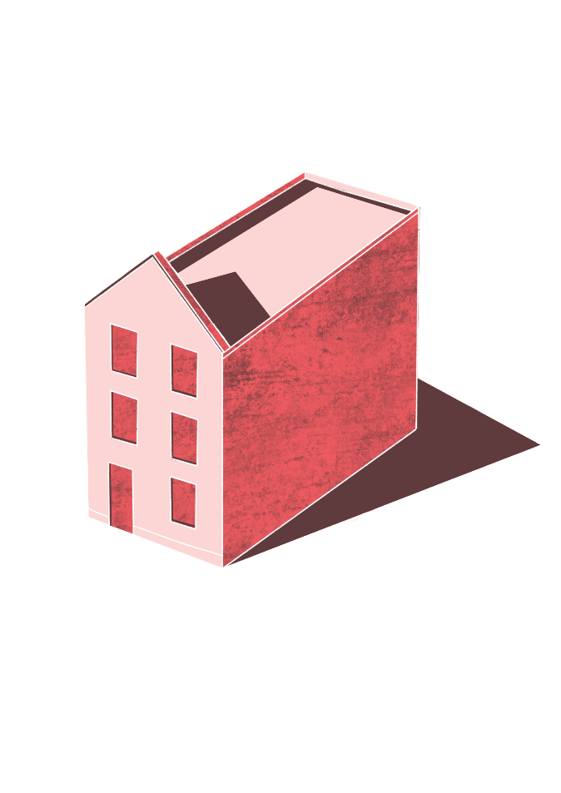
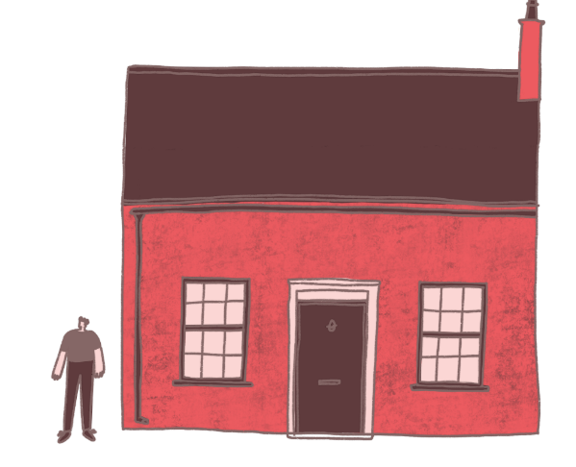
Exploring an Archive
“Every city is an archive…”
The buildings
The streets
The people
^{RIBA}
^{Learning_Mathematics Activity}

Slide 7
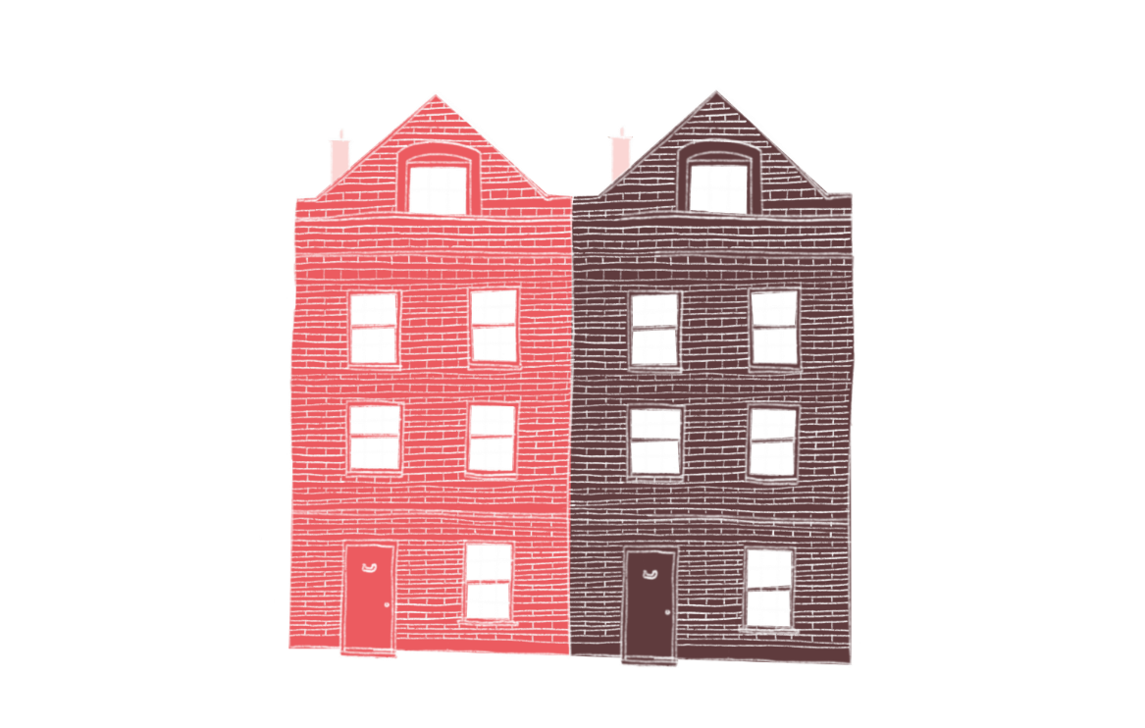
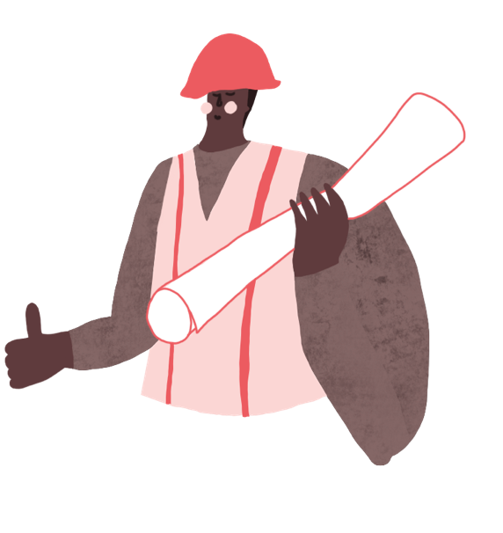
“Archives are active collections
We can contribute to the way the life of our city is recorded and preserved for the future.”
Explore and create a class archive.
What will go inside it?
^{RIBA}
^{Learning_Mathematics Activity}

