Slide 1
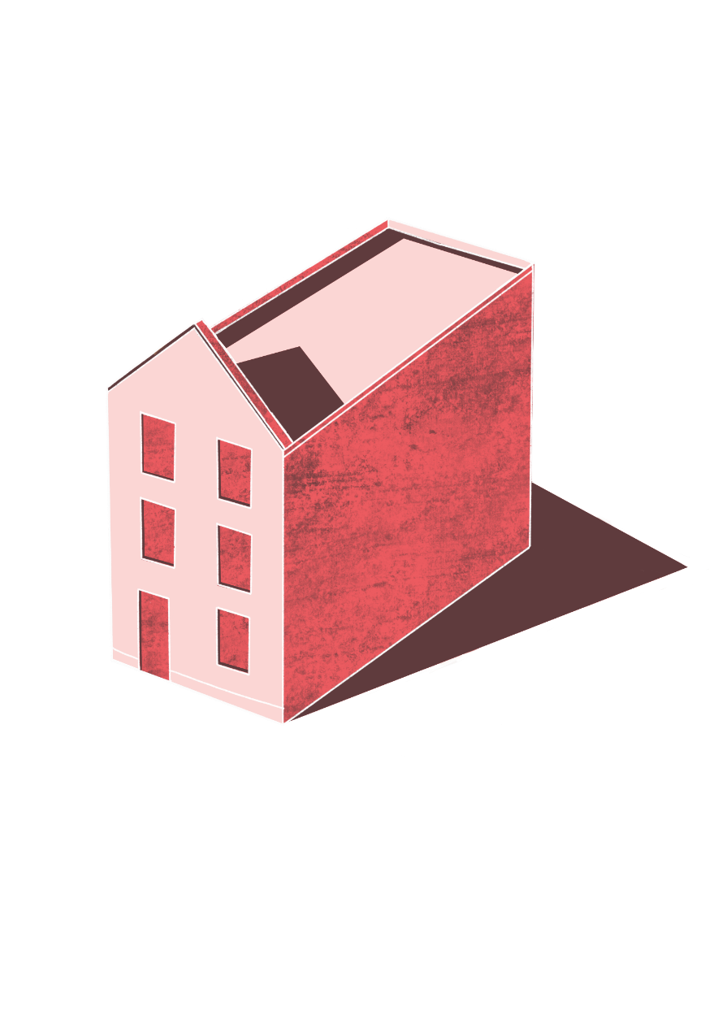

Proposing Spaces
^{‘LET’S MAKE A CHANGE!’}
KS2 | Learning Aims
Architecture | Learning Points
To be curious to know more about the past.
To ask perceptive questions and to think critically.
- To analyse and discuss a building, and propose our own improvements
- To produce a drawing of the building showing how we are making it more welcoming
^{RIBA}
^{Learning_Mathematics Activity}

Slide 2
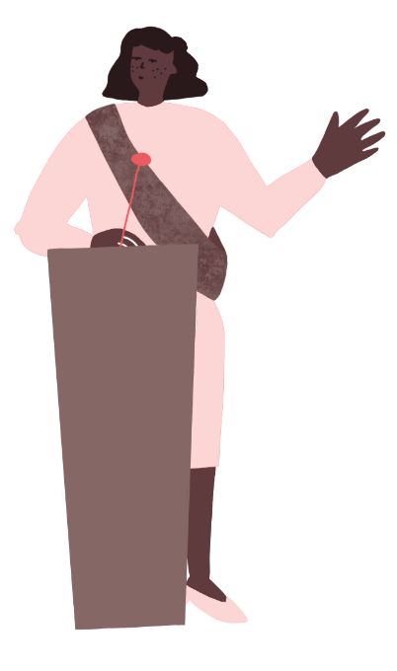
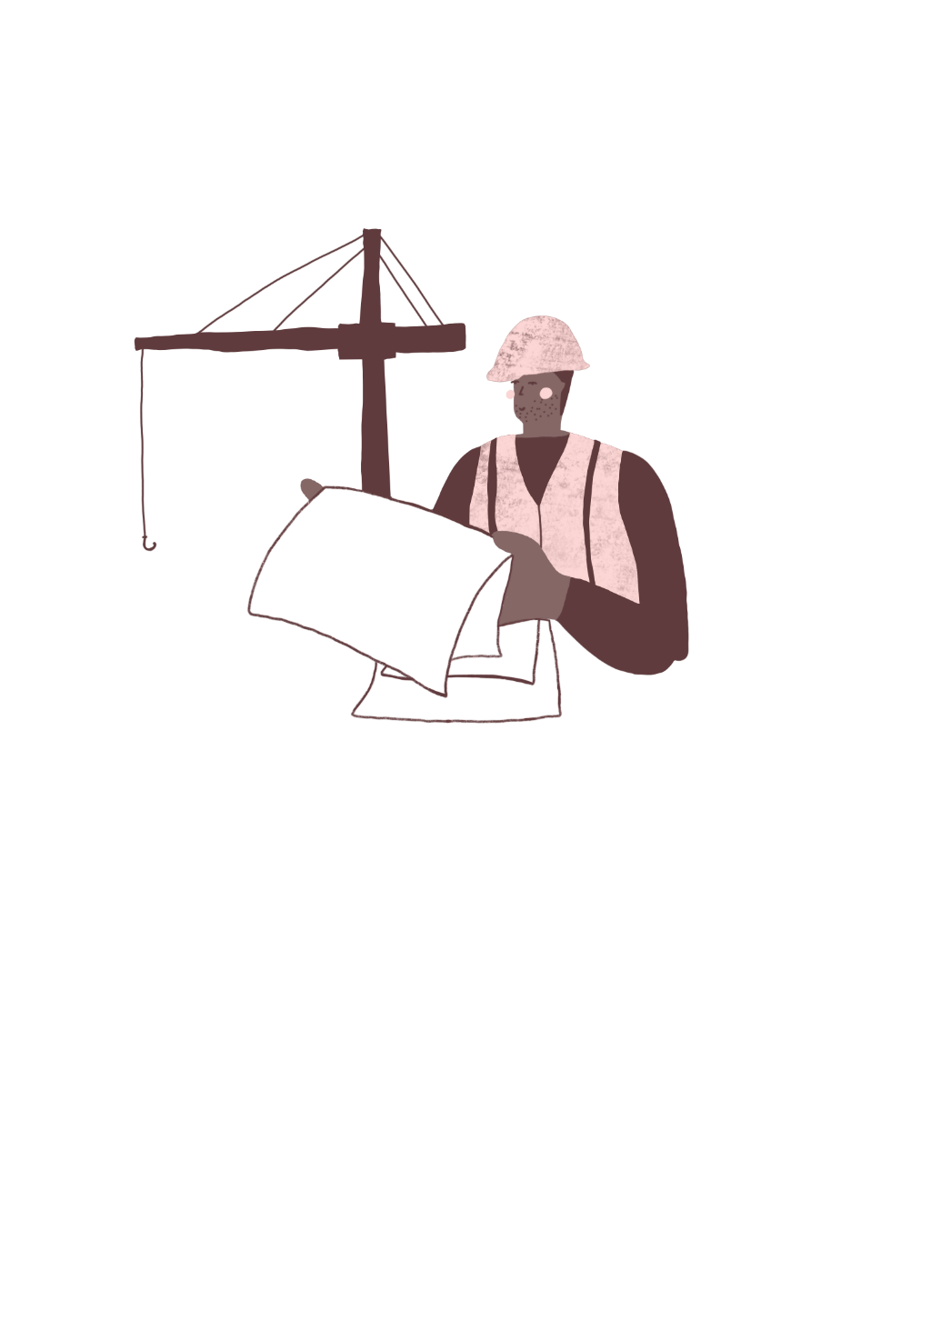
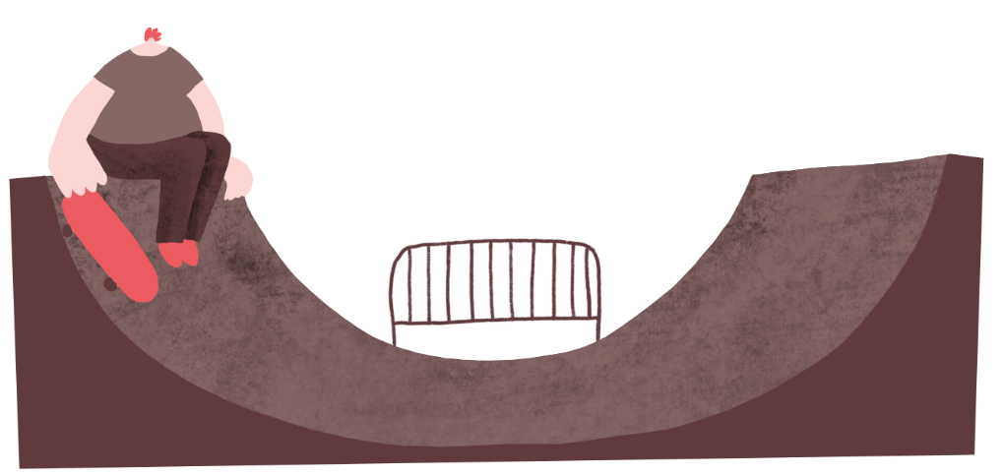
Activity 1:
Icebreaker: What’s in a City?
What types of buildings would the following people need:
Shopkeeper
Sportsperson
Family
Couple
Teacher
Librarian
Business woman
Politician
Farmer
Artist
Scientist
Gardener
^{RIBA}
^{Learning_Mathematics Activity}

Slide 3
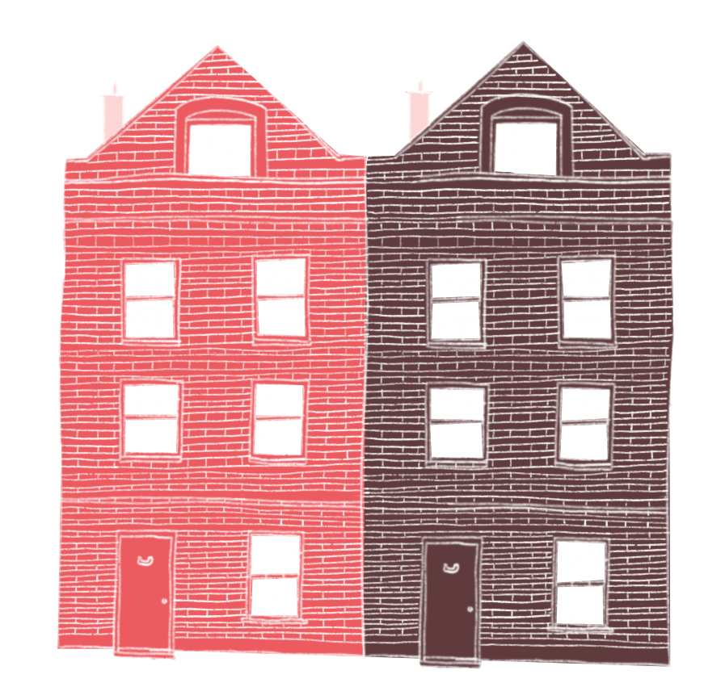
Activity 2:
Analysis
What makes a building welcoming or uninviting?
For example:
Large, clear entrance
Big windows
Types of materials
Signage
Decoration
Plants
^{RIBA}
^{Learning_Mathematics Activity}

Slide 4
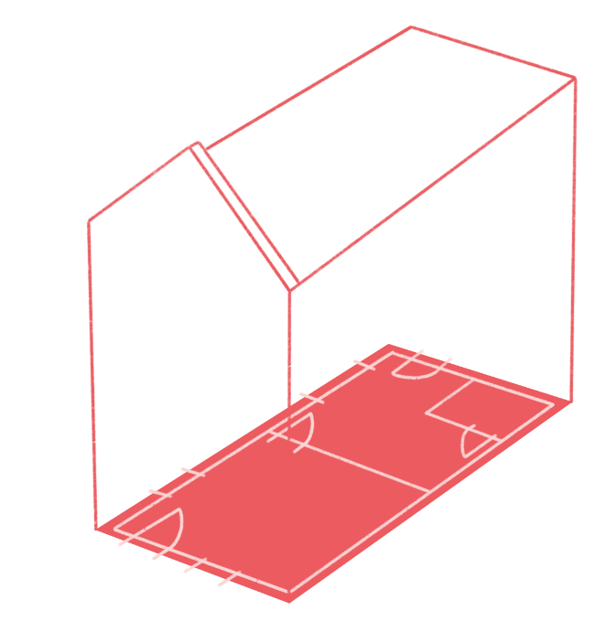
Activity 3:
Draw or make collage to show how you would make the building more welcoming and suitable for your person
Plan
A plan is a bird’s eye view of the building.
An elevation is the front view of the building.
You can either draw your new and improved building, or you can use collage techniques: Cut out old newspapers and magazines, and create your new building by sticking them down in a new arrangement with pritt stick.
Elevation
^{RIBA}
^{Learning_Mathematics Activity}

Slide 5
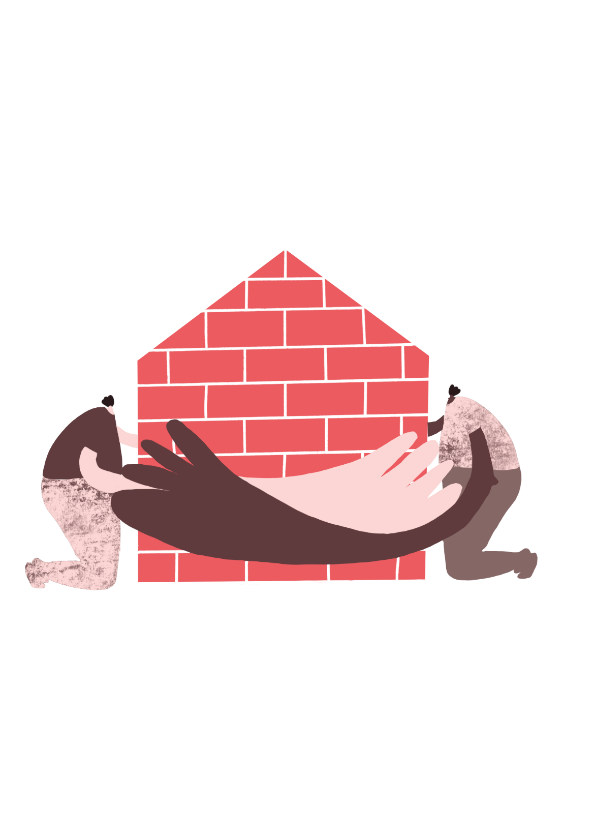

Activity 4:
Class review
“Present your idea to the rest of the class. They can then give helpful feedback. This mirrors what happens in many architecture schools and is known as a crit or a review.”
^{RIBA}
^{Learning_Mathematics Activity}

