Slide 1
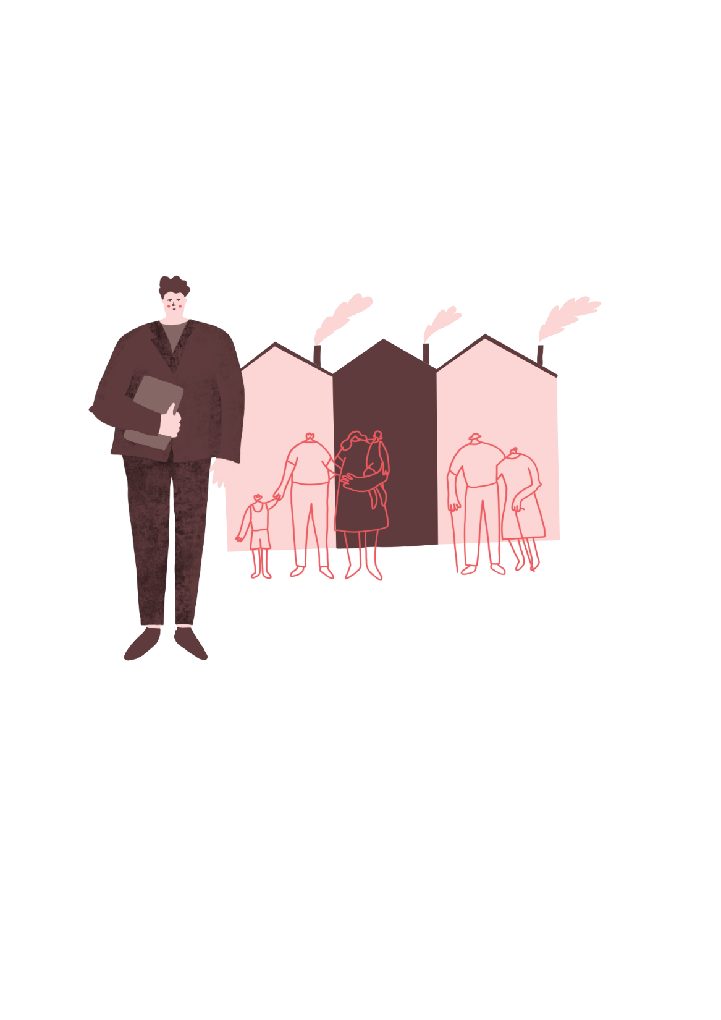

Planning Committee
^{‘LET’S MAKE A CHANGE!’}
KS2 | Learning Aims
Architecture | Learning Points
To be curious and analytical
To ask perceptive questions and to think critically
- To develop a greater awareness planning
^{- To improve empathy}
- To build on listening, negotiation and debating skills
^{RIBA}
^{Learning_Mathematics Activity}

Slide 2
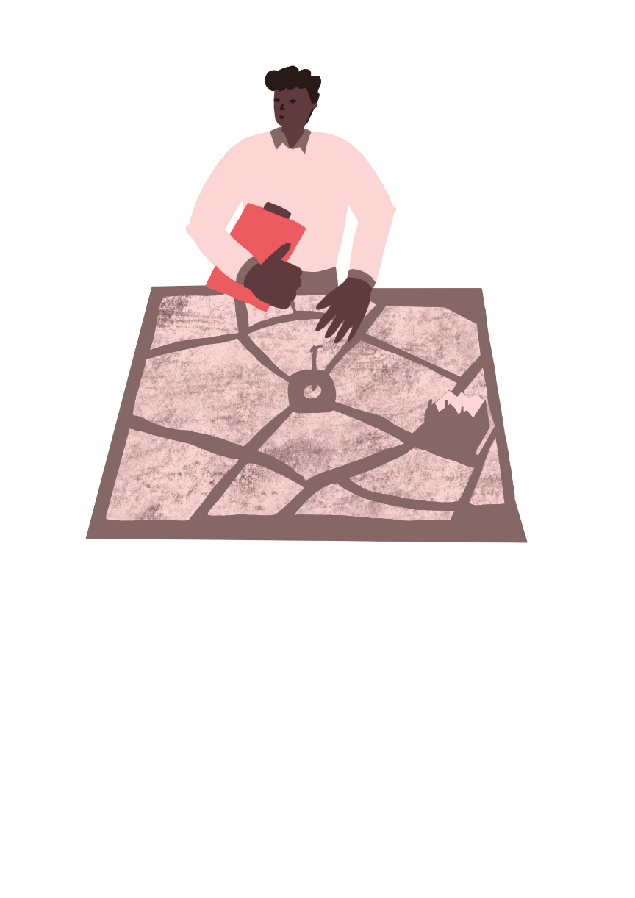

Activity 1:
Where do you think your building on the town plan that you have created with your teacher?
Write down all the reasons for why you think it should go in that location
  How close it is to main roads?
How close is it to the park?
Is it on the high street?
Is it in a quiet place?
Why does it need to be in this position?
How does this position support its function?
Try to make your reasons as strong as possible as you will be presenting them to the Planning Committee.
The Planning Committee will make the final decision as to where your building be located.
^{RIBA}
^{Learning_Mathematics Activity}

Slide 3
Planning Committee
Most planning committees are made up of the following people:
Town Planner
Residents’ Association Chair
Transport Manager
Local Councillor/Mayor
Everyone will have the opportunity to have a go at being each member.
In your group, brainstorm what you think each person does.
Feed this back to the whole class when your teacher asks you to.
^{RIBA}
^{Learning_Mathematics Activity}

Slide 4
Presenting your building
Within your group, organise yourself into the first committee meeting.
One person is the Architect, and they will present their building and where it will be located. Explain the benefits of its position.
“It is next to the park because…”
Everyone else takes on the following roles. Take turns to be each person:
Town Planner
Residents’ Association Chair
Transport Manager
Local Councillor/Mayor
Listen to the architect’s presentation.
^{RIBA}
^{Learning_Mathematics Activity}

Slide 5
Debate
Committee it’s over to you!
If there is anything you don’t understand, you can ask the architect a question or two.
Discuss within the committee whether you think the proposed location for the building is a good idea. You only have 5 minutes per building.
If you do not reach a consensus, you can take a vote.
If it is a yes, then the building will be locate in the architect’s proposed location.
If it is a no you must agree where it will be located instead.
Record the chosen location.
Repeat this debate process for each building in your group. Make sure you take on a different role each time
^{RIBA}
^{Learning_Mathematics Activity}

Slide 6

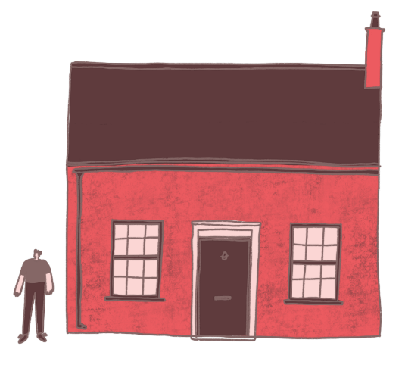
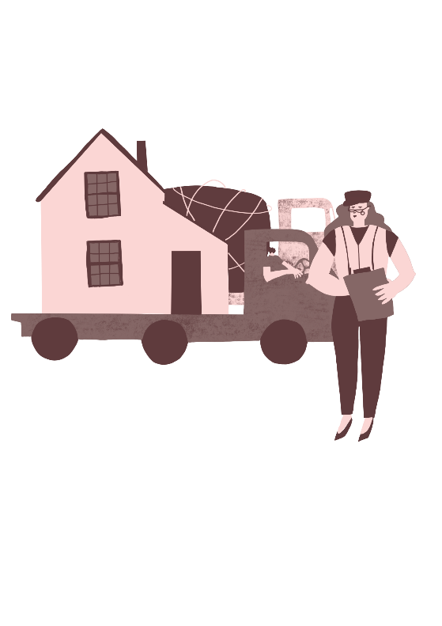

Activity 2:
Create the settlement!
On the plan your teacher drew at the start of the session, record where each building will go.
As a group consider:
Are there any other buildings we may need? If so what and where might they go?
How does all this join together? Do we need extra roads? Public transport? Cycle Routes?
Do we need any additional parks and green spaces?
^{RIBA}
^{Learning_Mathematics Activity}

Slide 7
Extension
Create a whole-town model!
Layout the drawings or models of the buildings you made in the previous lesson, in the arrangement you have just agreed.
Add the paths, cycle routes and roads, and the other spaces in-between.
Invite other classes or even your parents to come and see your new town!
^{RIBA}
^{Learning_Mathematics Activity}

